Slide 1
CCNA 200-301, Volume 2
Chapter 2
Basic IPv4 Access Control Lists

Slide 2
Objectives
Configure and verify standard access control lists

Slide 3
IPv4 Access Control List Basics
IPv4 access control lists give network engineers a way to identify different types of packets.
ACL configurations list values that the router can see in the IP, ICMP, TCP, and UDP (and other) headers.
IPv4 ACLs perform many functions in Cisco routers, including packet filtering and QoS.
Notes:
An ACL consists of one or more configuration commands, each matching a set of packets and then taking a permit/deny action.
An ACL always has a “deny any” statement at the end, which drops all packets not matching the previous criteria. This is an implicit statement meaning that you don’t actually see it in the running config or when you list the ACL. This statement can be overridden by configuring a “permit any any”command.
ACL statements are processed in a top-down order and only the first statement that matches is carried out (first-match logic).

Slide 4
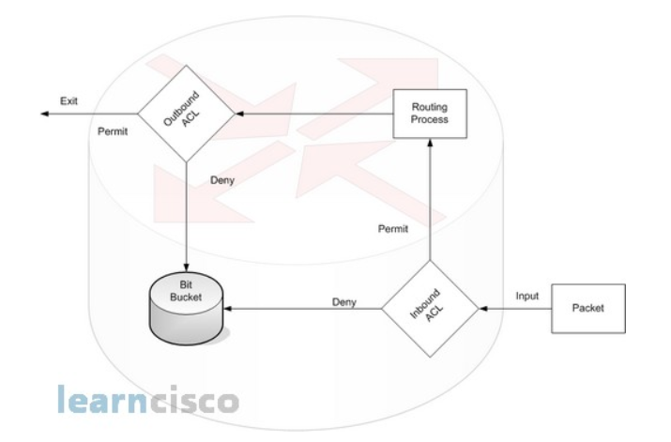

ACL Concepts
Notes:
Sources:
https://www.learncisco.net/courses/cisco-ccna/acls-and-nat/standard-ip-access-control-lists.html
https://www.configrouter.com/ccna-dc-faq-ipv4-access-control-lists-cisco-nexus-switches-8713/

Slide 5
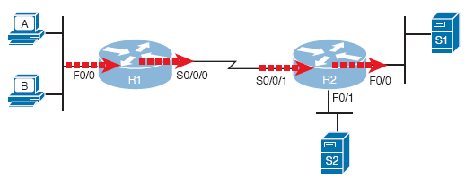
Locations to Filter Packets from Hosts A and B Going Toward Server S1
Standard ACLs only match the source IP address.
Notes:
ACLs are applied to router interfaces either to incoming traffic (inbound) or to outgoing traffic (outbound).
A standard ACL should be applied as close to the destination as possible, to avoid filtering packets destined for other destinations. On the other hand, an extended ACL should be applied as close to the source as possible in order to save BW, because we have the capability to specify the destination. We do not talk about extended ACLs in this course.

Slide 6
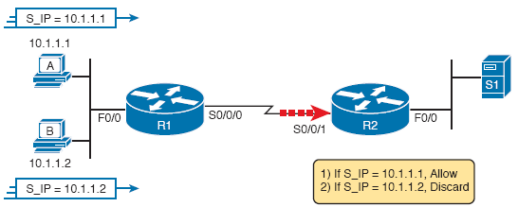
Pseudocode to Demonstrate ACL Command-Matching Logic
Is S0/0/1 a better place to put the ACL or F0/0 on R1?

Slide 7
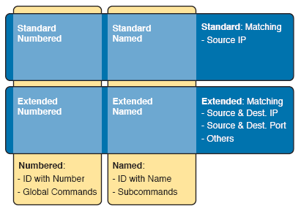
Comparisons of IP ACL Types
1-99
1300-1999
Notes:
In this lecture, we will only focus on IPv4 standard numbered ACLs.
A standard ACL matches only the source IP address, while an extended ACL can match other headers such as destination IP address, src/dest port numbers, protocol type, etc.

Slide 8
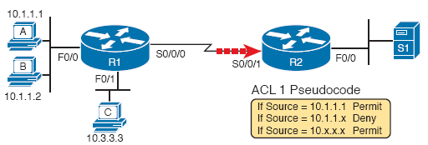
Backdrop for Discussion of List Process with IP ACLs
Notes:
What would happen if the second and the third commands were swapped? Think of 10.1.1.2 as an example.

Slide 9
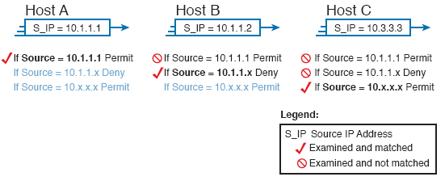
ACL Items Compared for Packets from Hosts A, B, and C on Previous Slide
Notes:
Always put the most specific commands first.

Slide 10
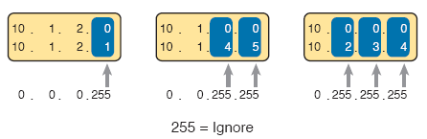
Logic for WC Masks 0.0.0.255, 0.0.255.255, and 0.255.255.255
Notes:
Note: Instead of subnet masks, wildcard masks are used to identify a source or a destination subnet. For example, 0.0.0.255 is the wildcard mask corresponding to a subnet mask of 255.255.255.0.

Slide 11
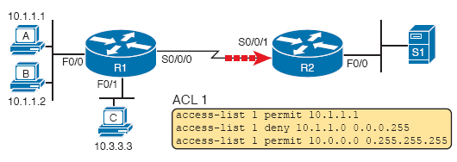
Syntactically Correct ACL Replaces Pseudocode

Slide 12

Binary Wildcard Mask Example
For subnet 172.16.8.0 255.255.252.0, use the subnet number as the address parameter and do the following math to find the wildcard mask:
Notes:
Note: A wildcard mask is not always the inverted form of a subnet mask. For example, 0.0.255.0 can be a wildcard mask, while 255.255.0.255 is not a subnet mask. In general, a wildcard mask is a matching rule that indicates which bits must match, no matter where in the IP address they are. This is particularly helpful when you need to match multiple IP addresses that do not belong to the same subnet.
Example: access-list 1 permit 10.1.0.1 0.0.255.0
This command would match addresses such as 10.1.1.1, 10.1.100.1, 10.1.220.1, …

Slide 13
Matching Any/All Addresses
In some cases, one ACL command can be used to match any and all packets that reach that point in the ACL, using the any keyword.
Example: access-list 1 permit any.
All Cisco IP ACLs end with an implicit¹ deny any.
Notes:
1. This command is not shown in the running configuration.

Slide 14
Implementing Standard IP ACLs
Step 1: Plan the location and direction on that interface
Step 2: Configure one or more access-list global configuration commands to create the ACL
Step 3: Enable the ACL on the chosen router interface, in the correct direction, using the ip access-group number {in | out} interface subcommand.

Slide 15
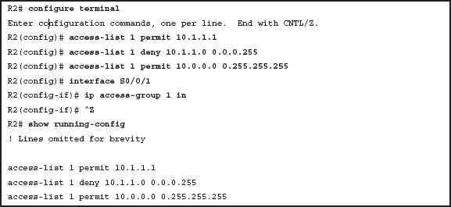
Standard Numbered ACL Example 1 Configuration
Applies the ACL 1 inbound to the Serial0 interface.

Slide 16
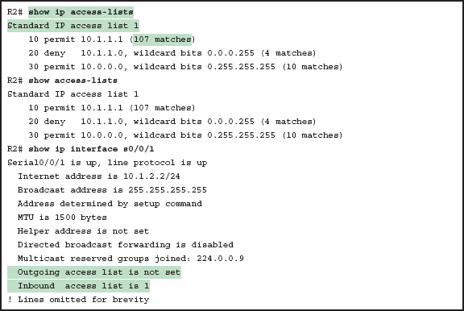
ACL show Commands on R2
Notes:
The command “show interface” can also be used to see the list of applied ACLs to an interface.

Slide 17
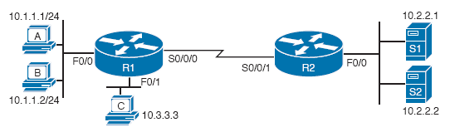
Standard Numbered ACL Example 2

Slide 18
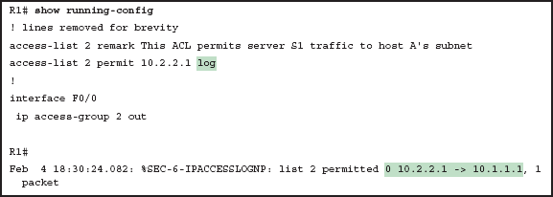
Creating Log Messages for ACL Statistics
Notes:
The command “ip access-group” is used to apply an ACL to an interface.
The keyword “remark” is used to leave a comment.
The log keyword causes log messages to be created every time the command is matched.

Slide 19
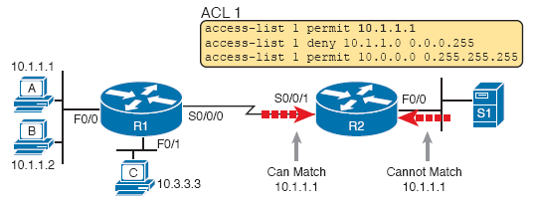
Example of Checking the Interface and Direction for an ACL
Why?
Notes:
A standard ACL only checks the source IP address.

Slide 20
Building One-Line Standard ACLs: Practice
Problem | Criteria
1 | Packets from 172.16.5.4
2 | Packets from hosts with 192.168.6 as the first three octets
3 | Packets from hosts with 192.168 as the first two octets
4 | Packets from any host
5 | Packets from subnet 10.1.200.0/21
6 | Packets from subnet 10.1.200.0/27
7 | Packets from subnet 172.20.112.0/23
8 | Packets from subnet 172.20.112.0/26
9 | Packets from subnet 192.168.9.64/28
10 | Packets from subnet 192.168.9.64/30

Slide 21

Reverse Engineering from ACL to Address Range
With the command access-list 1 permit 172.16.200.0 0.0.7.255, the low end of the range is 172.16.200.0.
To find the high end of the range, add this number to
the WC mask, as shown here:

Slide 22
Finding IP Addresses/Ranges Matching by Existing ACLs
Problem | Criteria
1 | access-list 1 permit 10.7.6.5
2 | access-list 2 permit 192.168.4.0 0.0.0.127
3 | access-list 3 permit 192.168.6.0 0.0.0.31
4 | access-list 4 permit 172.30.96.0 0.0.3.255
5 | access-list 5 permit 172.30.96.0 0.0.0.63
6 | access-list 6 permit 10.1.192.0 0.0.0.31
7 | access-list 7 permit 10.1.192.0 0.0.1.255
8 | access-list 8 permit 10.1.192.0 0.0.63.255

Slide 23
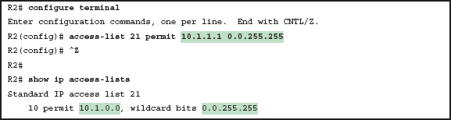
IOS Changing the Address Field in an access-list Command
Notes:
Regardless of the IP address used in the access-list command, the verification commands always show the lower end of the range and the wildcard mask.

Slide 24
Summary
ACLs: standard vs extended, numbered vs. named
First-match logic
Implicit deny any statement
Applied inbound or outbound on an interface
Apply standard ACLs close to the destination.
Wildcard masks to specify an address range

